Slide 1


WELCOME
TO

Slide 2
FUNDAMENTALS OF DATA ANALYTIC WITH TABLEAU
PROJECT TITLE:
Irevolution: A Data-Driven Exploration of Apple's Iphone Impact In India

Slide 3

Project Title
The Tableau Irevolution: A Data-Driven Exploration of Apple's Iphone Impact in India
This is a group project. We have include four members on the project.Namely,
I am the TEAM LEAD: SRINIVASAN S, TEAM PERSONS: VIJAYAKANTH A, MUTHAMIZH ARASU K, RAGUL V
Team NM ID: NM2023TMID16074
IIIrd B.Sc.Mathematics
Under The Guidance of
S.SATHISH,M.Sc.,M.phil.,
GUEST LECTURER PG & RESEARCH DEPARTMENT OF MATHEMATICS,
GOVERNMENT THIRUMAGAL MILLS COLLEGE,
GUDIYATTAM-632602

Slide 4
INTRODUCTION
1.OVERVIEW
The world has changed as a consequence of the increasing use of smartphones,which have improved communication, connected people, and revolutionized many different businesses. With its main product, the iphone,capturing markets around the world, Apple Inc. Has emerged as a prominent player among the top smartphones makers. India,one of the economics with the greatest ecomic growth , has seen a tremendous increase in smartphones usage , making it an interesting market to study the effects of Apple's iphone.

Slide 5
2.PURPOSE
Let us analyze the Data Driven Exploration of apple's iphone impact in India
Apple has a special chance to increase its market share and develo a significant presence in India

Slide 6
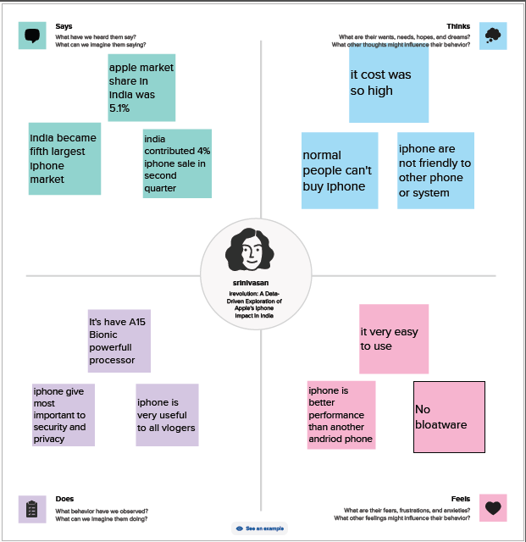
PROBLEM DEFINING & DESING THINKING 2.1 Empathy Map

Slide 7
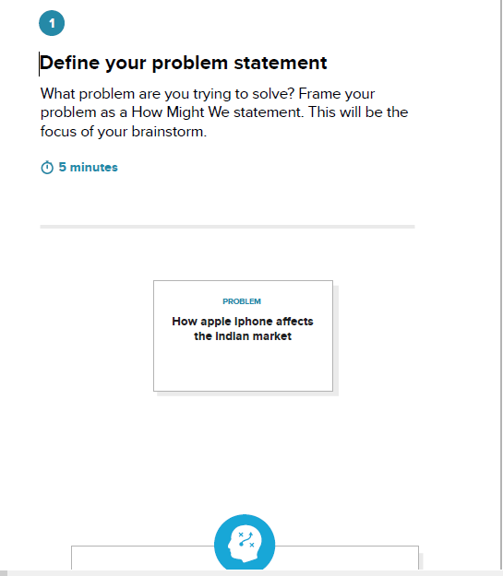
2.2 IDEATION & BRAINSTROMING MAP

Slide 8
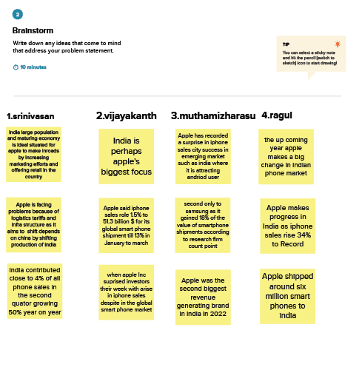

Slide 9
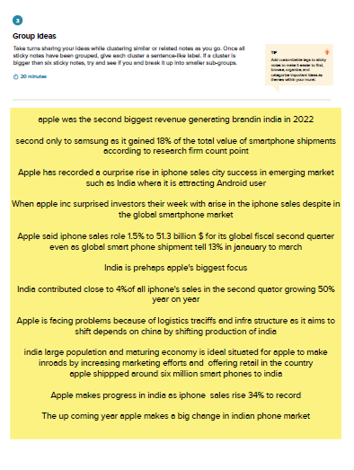
.

Slide 10
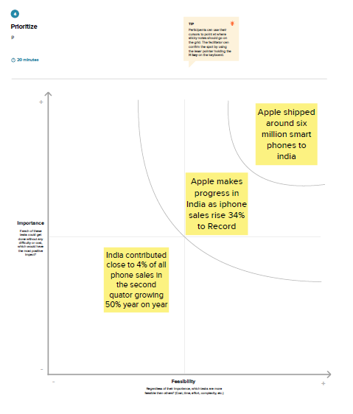
.

Slide 11
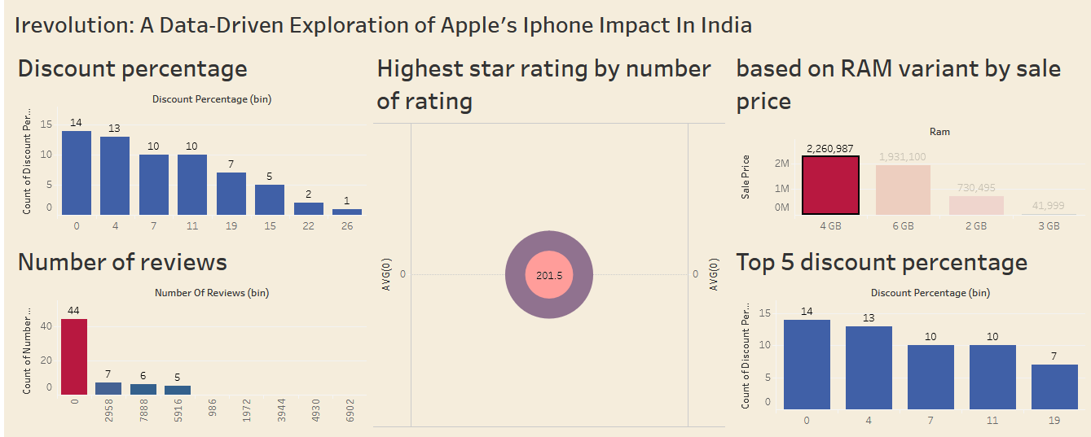
3. RESULT: Final findings (output) of the project

Slide 12
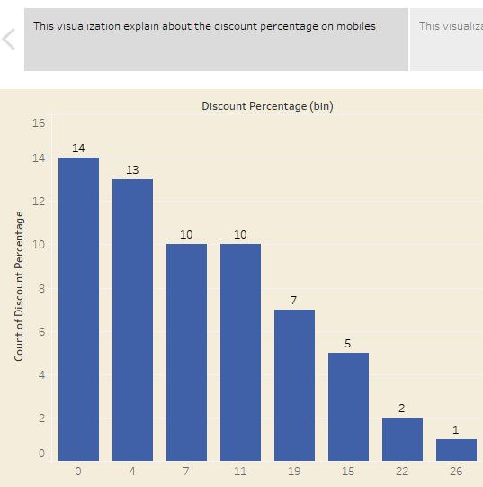
Irevolution: A Data- Driven Exploration of Apple's Iphone Impact In India
Story
Visualization
1:

Slide 13
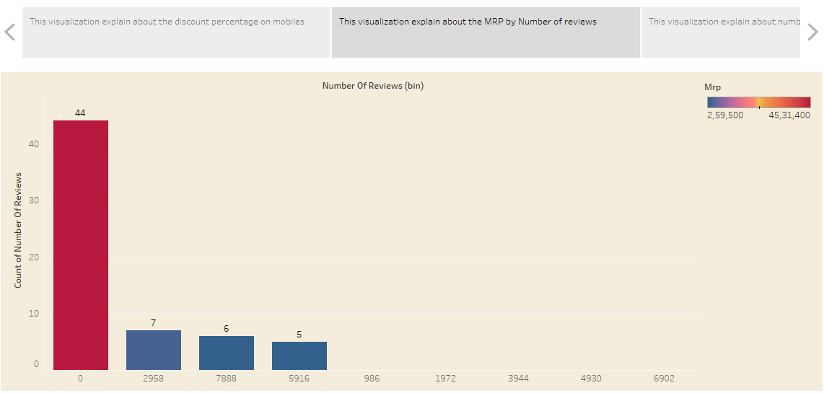
Irevolution: A Data- Driven Exploration of Apple's Iphone Impact In India
Story
Visualization
2:

Slide 14
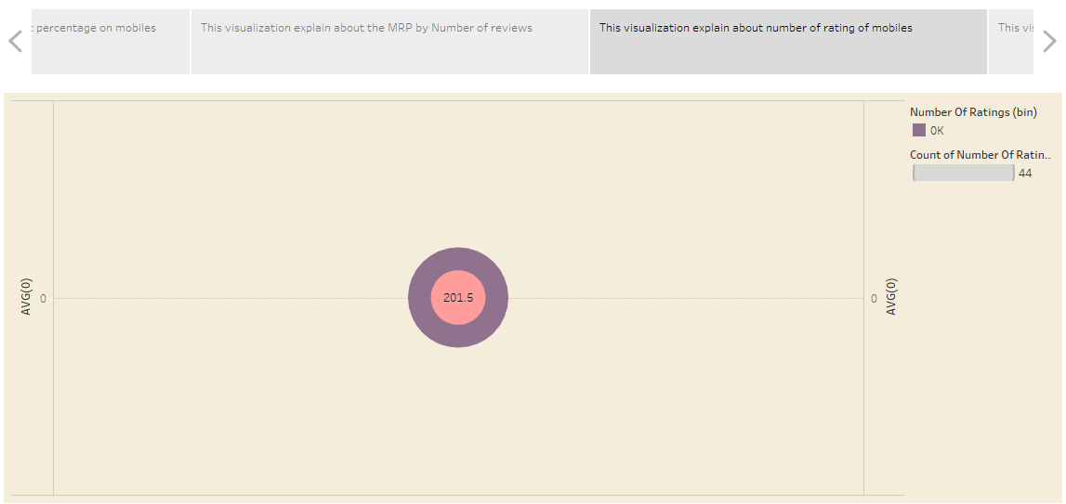
Irevolution: A Data- Driven Exploration of Apple's Iphone Impact In India
Story
Visualization
3:

Slide 15
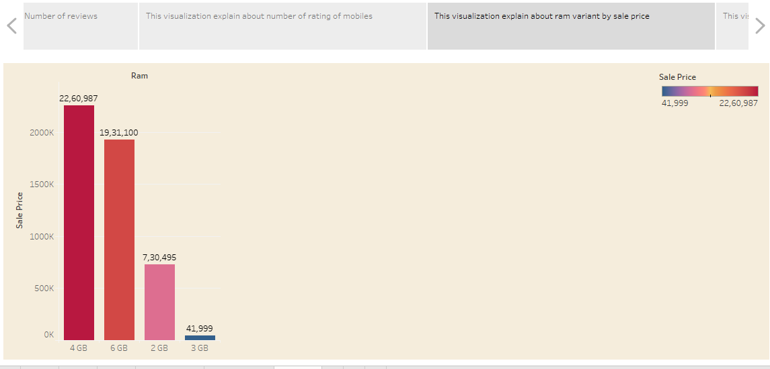
Irevolution: A Data- Driven Exploration of Apple's Iphone Impact In India
Story
Visualization
4:

Slide 16
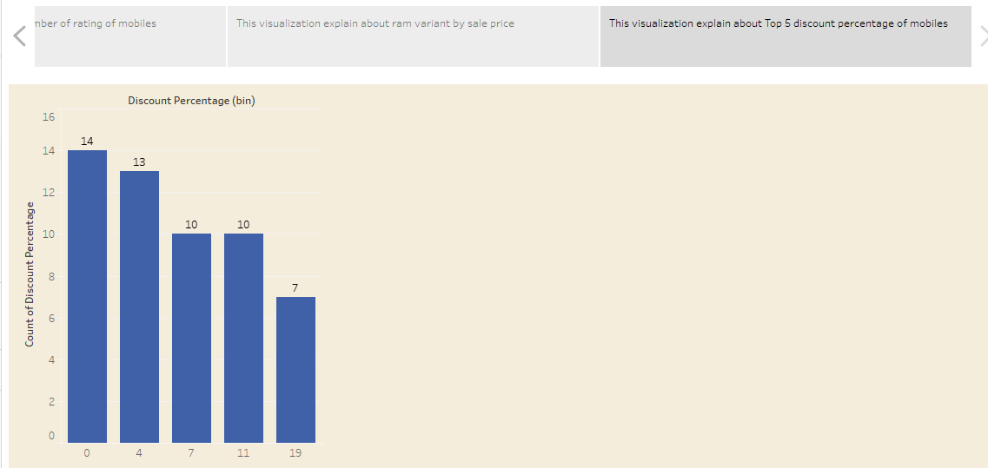
Irevolution: A Data- Driven Exploration of Apple's Iphone Impact In India
Story
Visualization
5:

Slide 17
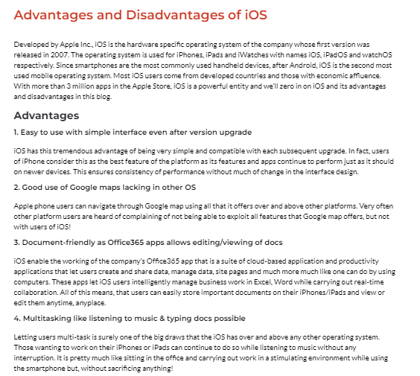
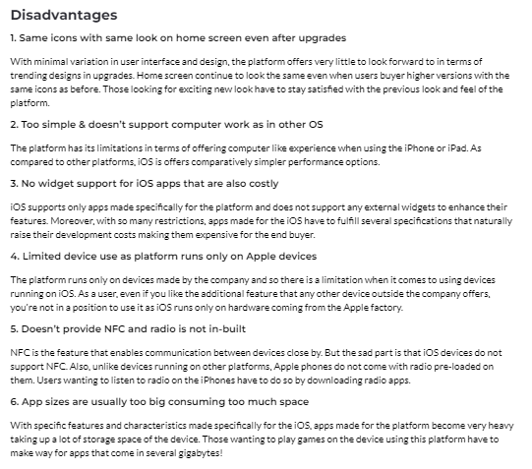
4.ADVANTAGES & DISADVANTAGES:

Slide 18
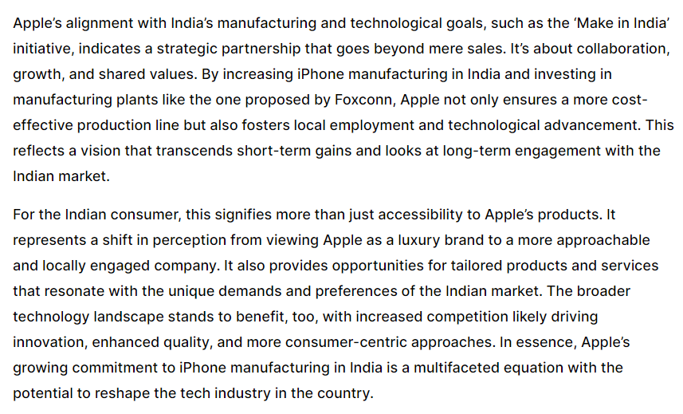
6.IMPACT OF IPHONE IN INDIA

Slide 19
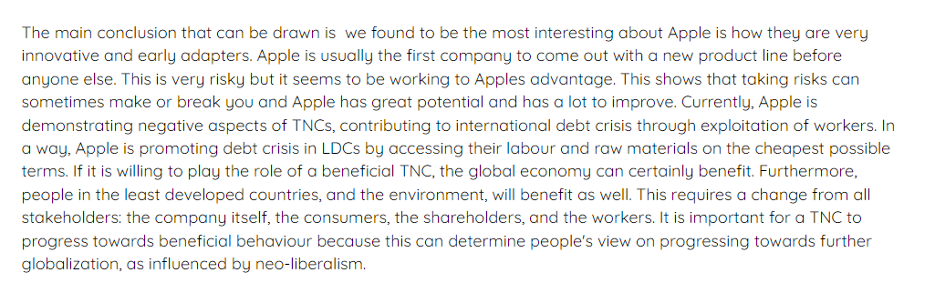
7.CONCLUSION

Slide 20
DASHBOARD LINK:
https://public.tableau.com/views/IrevolutionAData-DrivenExplorationofApplesIphoneInIndia/Dashboard2?:language=en-US&:display_count=n&:origin=viz_share_link
STORY LINK:
https://public.tableau.com/views/IrevolutionAData-DrivenExplorationofApplesIphoneInIndia_16968588980120/Story1?:language=en-US&:display_count=n&:origin=viz_share_link

Slide 21

.

